Slide 1
Individual Homework

Slide 2
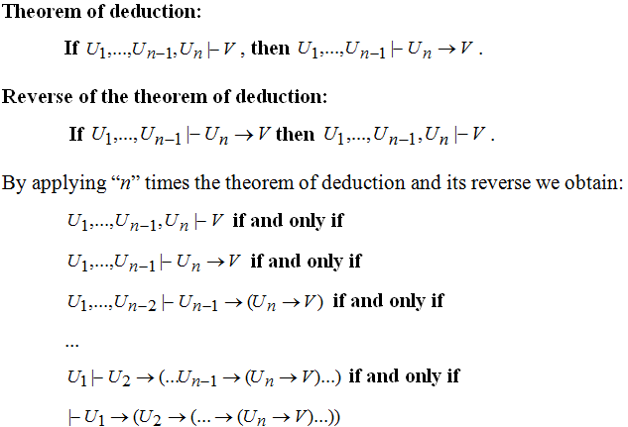

Slide 3
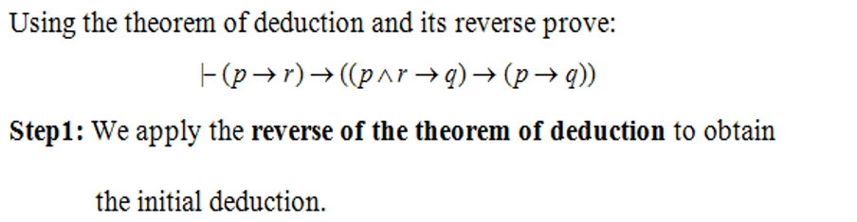

p → ( ­­­­¬ q → r ) ⊢ (¬ ( p → q ) → ( p → r)) then
p → ( ­­­­¬ q → r ) , (¬ ( p → q )) ⊢ p → r then
p → ( ­­­­¬ q → r ) , (¬ ( p → q )) , p ⊢ r then
p →(­­­­¬ q → r) , (¬ ( p → q )) , p ⊢ r
p→ q ˅ r , ¬ p ˅ q, p ⊢ r

Slide 4
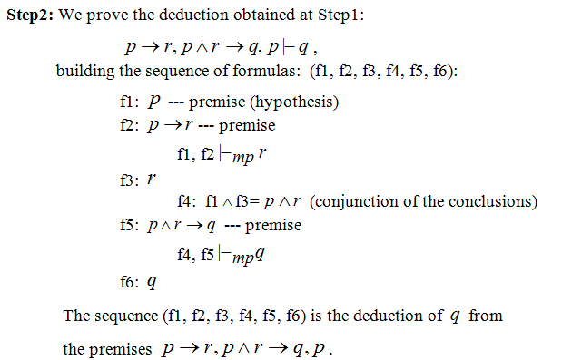
p→ q ˅ r , ¬ p ˅ q, p ⊢ r
Building se sequence of formulas:
f1: p
f2: ¬ p ˅ q ( ≡ ¬ ( p → q ))
f1, f2 ⊢_{mp} ¬ q
f3: ¬ q
f4: q ˅ r
f3, f4 ⊢_{mp} r
f5: r
The sequence (f1, f2, f3, f4, f5) is the deduction of q from the premises : p→ q ˅ r , ¬ p ˅ q, p ⊢ r

Slide 5
Step3: We apply three times the theorem of deduction
If p , ­­­­¬ q → r , ¬ ( p → q ) , p ⊢ r then
p , ( ­­­­¬ q → r ) , (¬ ( p → q ) ⊢ ( p → r)) then
p , ( ­­­­¬ q → r ) ⊢ (¬ ( p → q ) → ( p → r)) then
⊢ (p → ( ­­­­¬ q → r ) → (¬ ( p → q ) → ( p → r)) - Theorem to be proven

